Slide 1



3D Geometry-based
Neural Camera Pose Estimation
Hugo GERMAIN
1

Slide 2
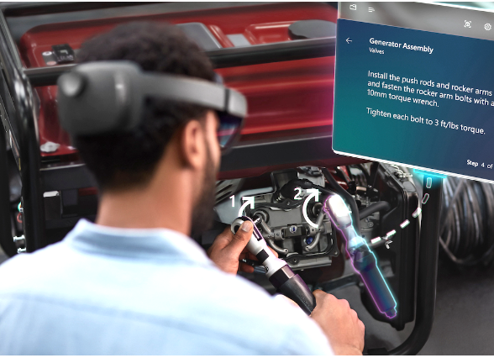
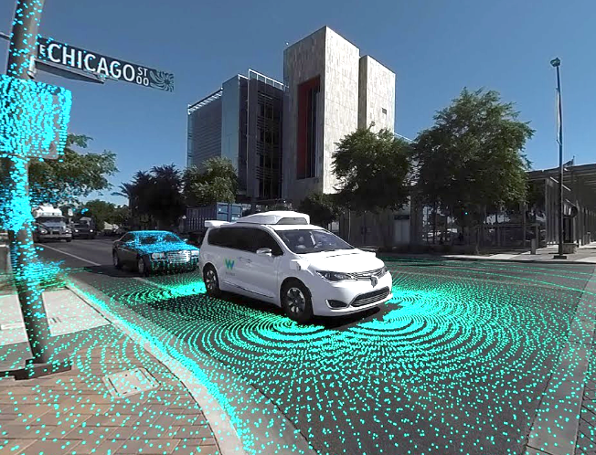
Localization is a crucial piece of many robotics applications
?
> Microsoft
> Waymo
Mixed / Augmented Reality
Robotics / Autonomous Driving

Slide 3
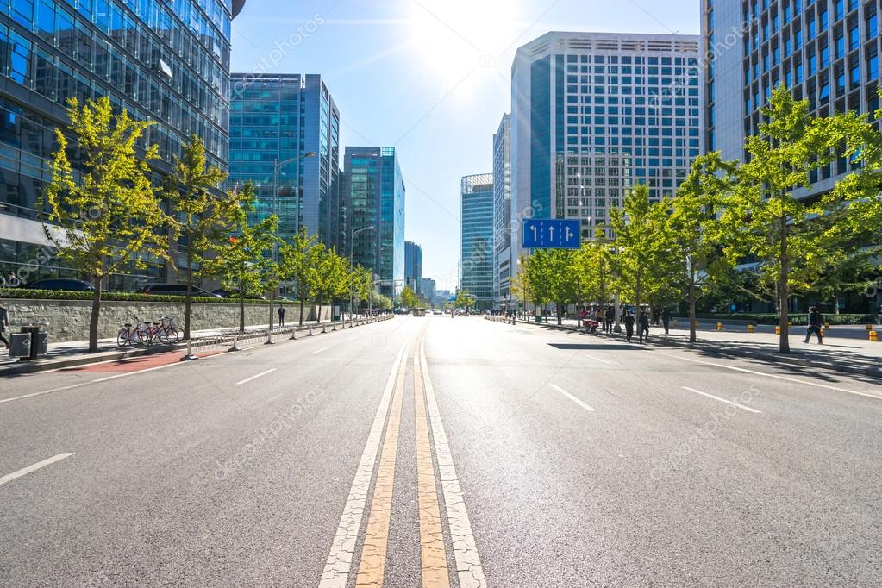
Localization is a crucial piece of many robotics applications
?
> Microsoft
> Waymo
Mixed / Augmented Reality
Robotics / Autonomous Driving
3D position and
3D orientation (6 degrees-of-freedom in total)
from an image

Slide 4
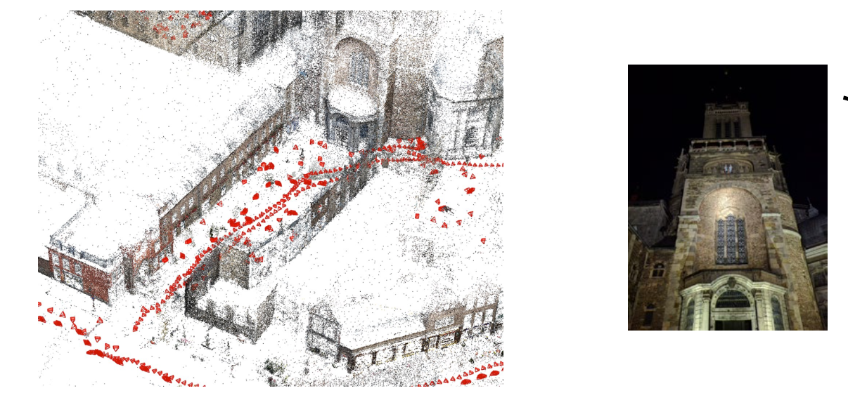
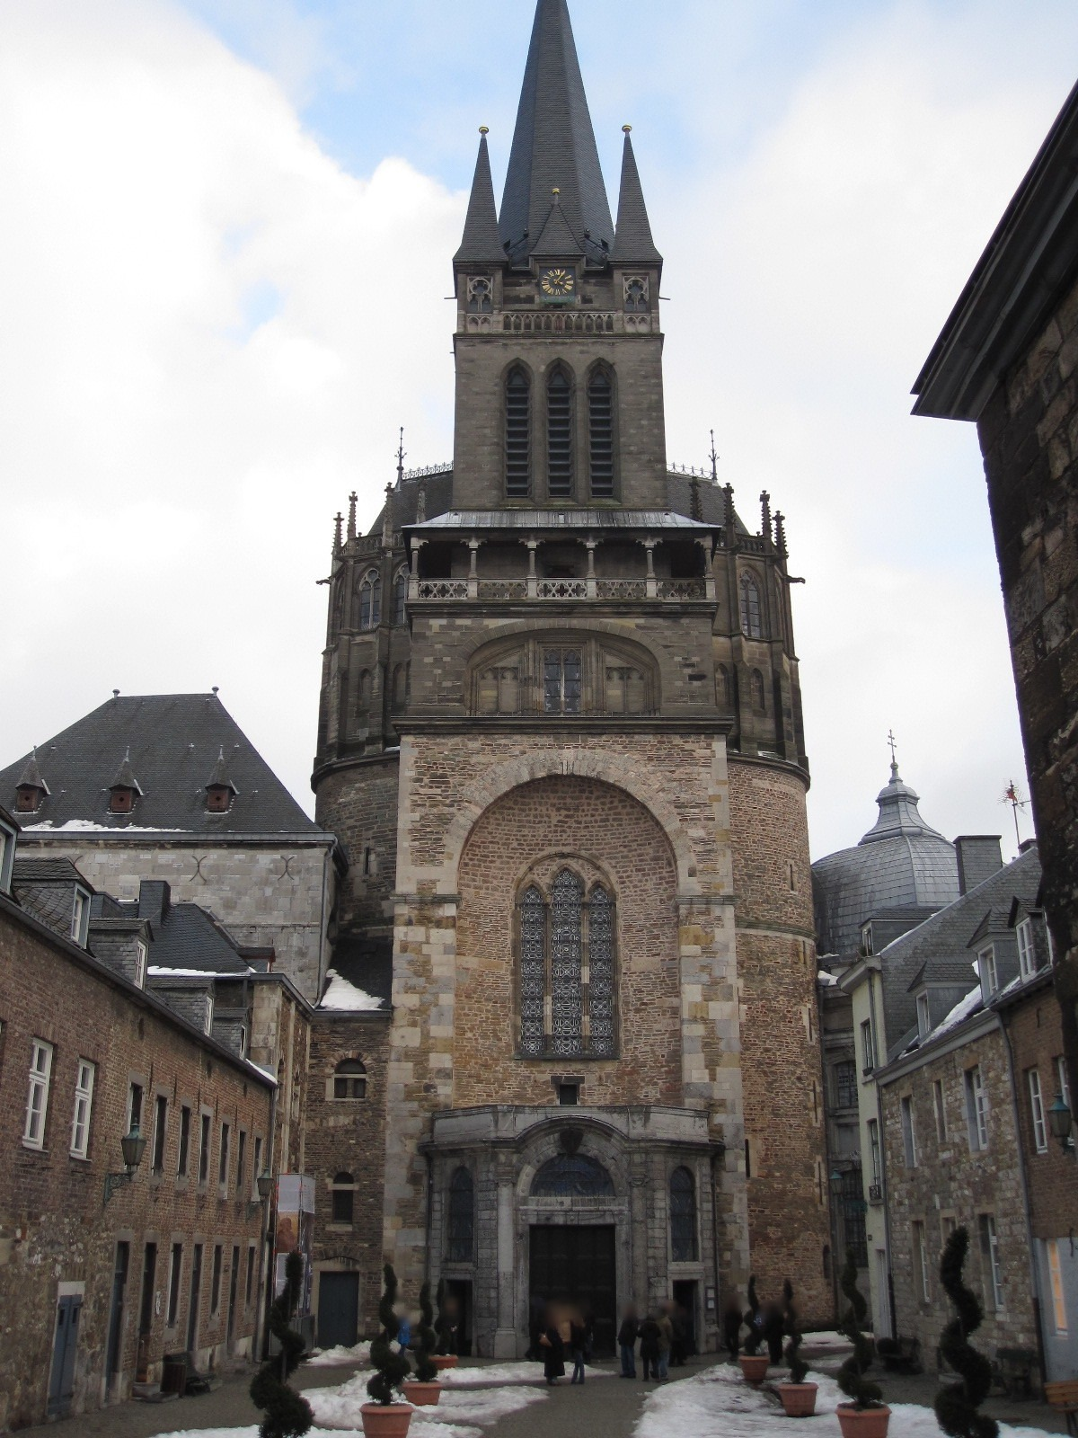
General Approach (offline step)
Posed database images
SfM 3D Model

Slide 5
General Approach (online step)
Structure-based pose estimation as a 2D-2D problem
Query Image
Posed database image
SfM 3D Model

Slide 6
The sparse-to-sparse matching paradigm
The 40 years-old way of finding correspondences
Keypoint Detection
Keypoint
Matching
Keypoint Detection

Slide 7
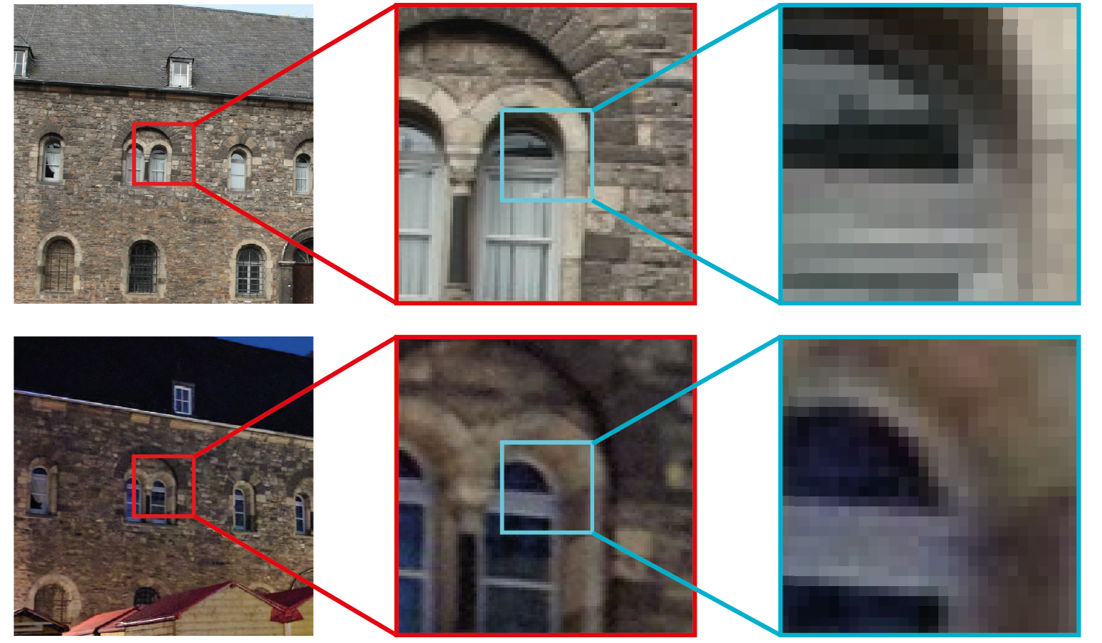
One challenge of sparse-to-sparse matching
The keypoint repeatability problem
Source Detections
daytime
image
Best possible correspondences
nighttime
image
SIFT [Lowe, 2004]
SURF [Bay, 2006]
SuperPoint [Detone, 2018]
D2-Net [Dusmanu, 2019]
R2D2 [Revaud, 2019]
Nearest Target Detections

Slide 8
Our sparse-to-dense matching paradigm
Keypoint Detection

Slide 9
Our sparse-to-dense matching paradigm
Keypoint Detection
Exhaustive search
This can be done efficiently on GPU

Slide 10
Our sparse-to-dense matching paradigm
Keypoint Detection

Slide 11
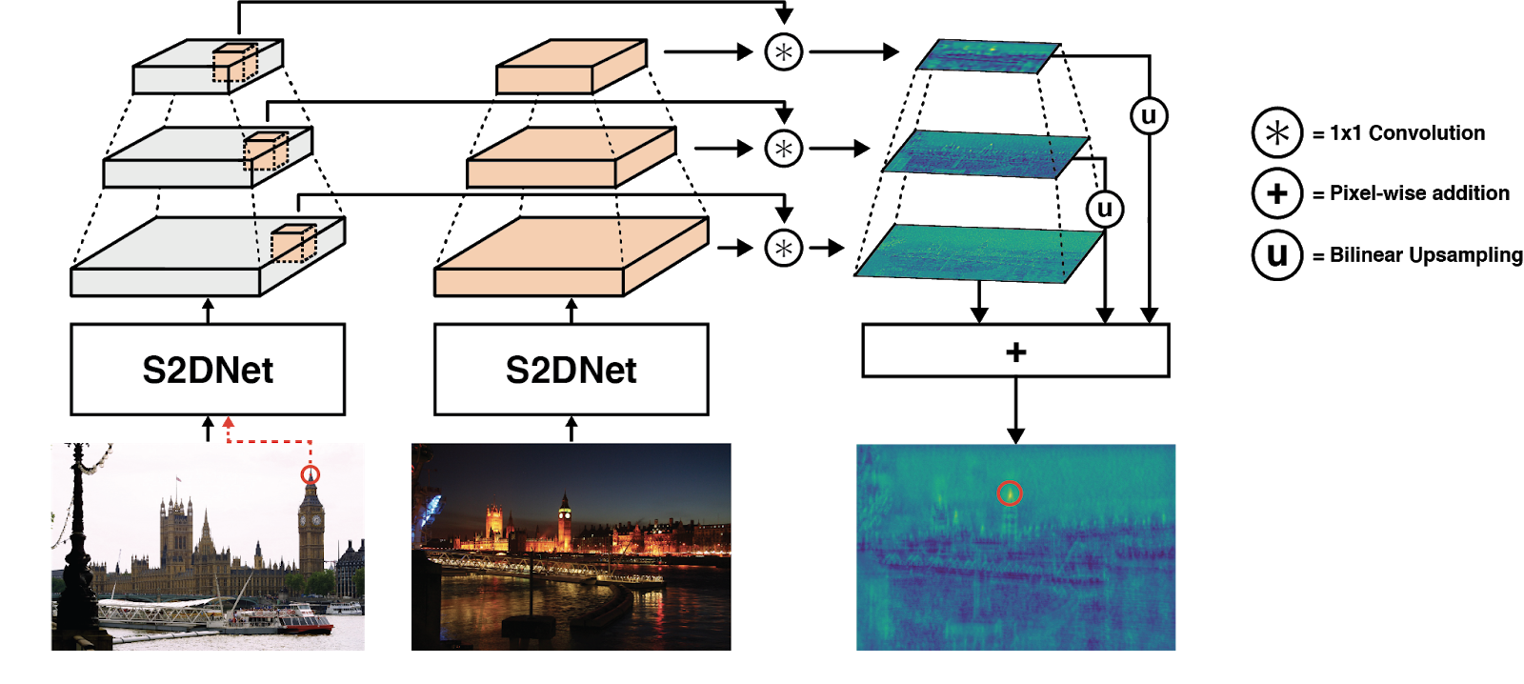
Learning a pixel representation for robust search
Database Image
Query Image
Dense Correlation Map
> S2DNet: Learning Accurate Correspondences for Sparse-to-Dense Feature Matching, H. Germain, G. Bourmaud, V. Lepetit, ECCV 2020

Slide 12
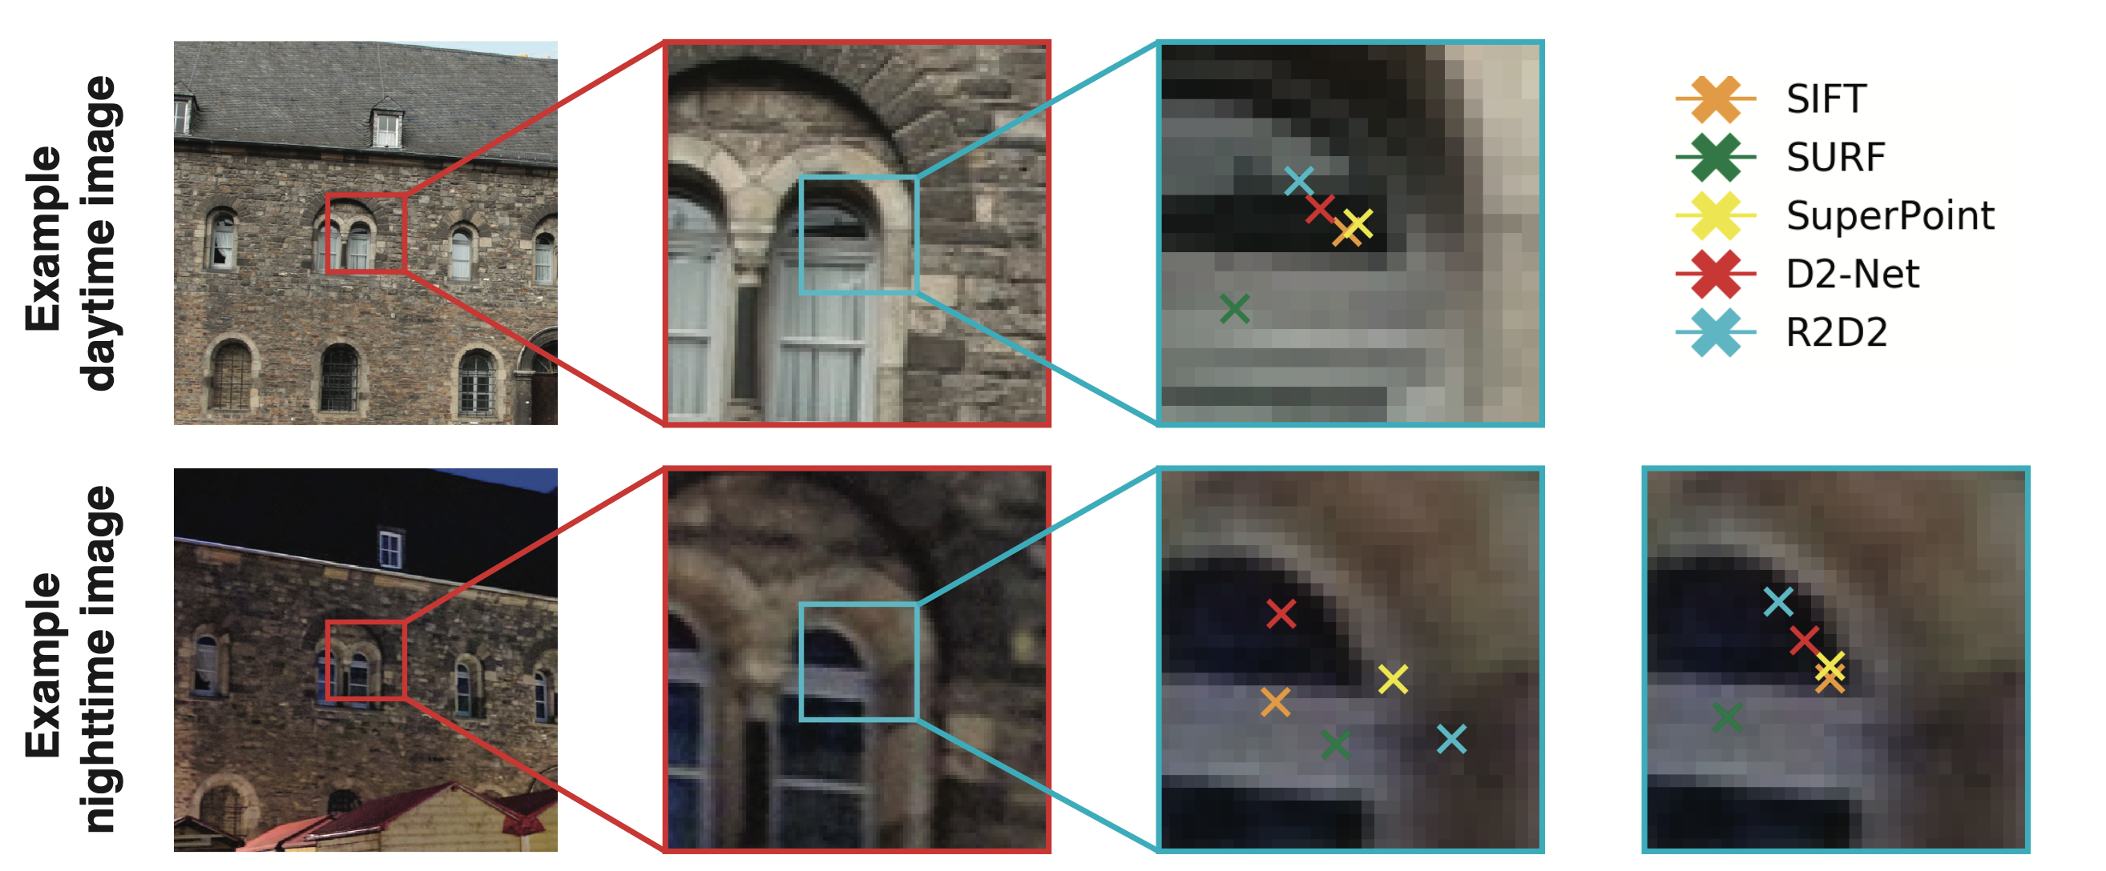
Qualitative results
Avoiding the keypoint repeatability problem
daytime
image
nighttime
image
Nearest Detections
S2DNet (Ours)
> S2DNet: Learning Accurate Correspondences for Sparse-to-Dense Feature Matching, H. Germain, G. Bourmaud, V. Lepetit, ECCV 2020

Slide 13
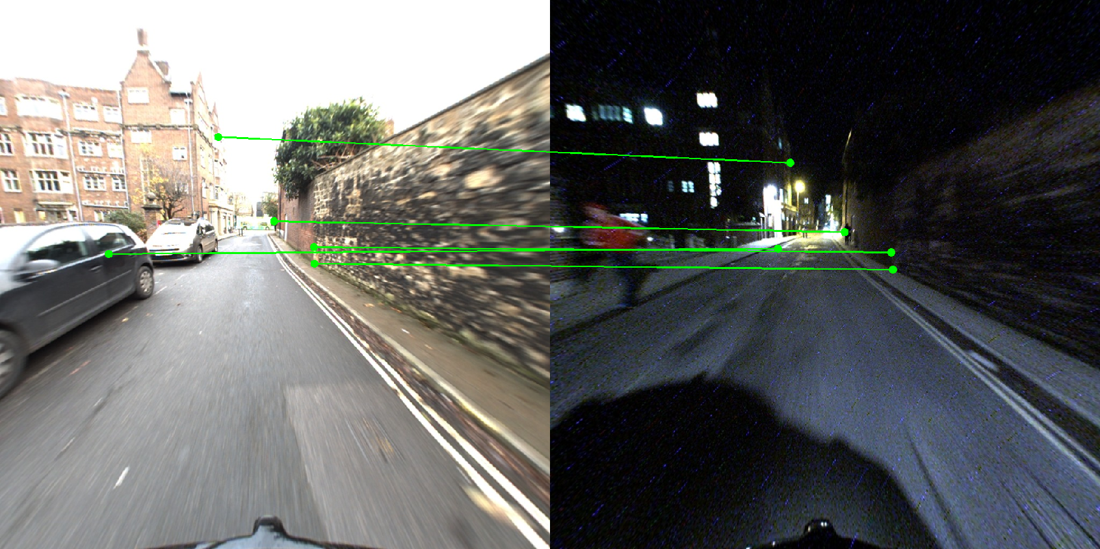
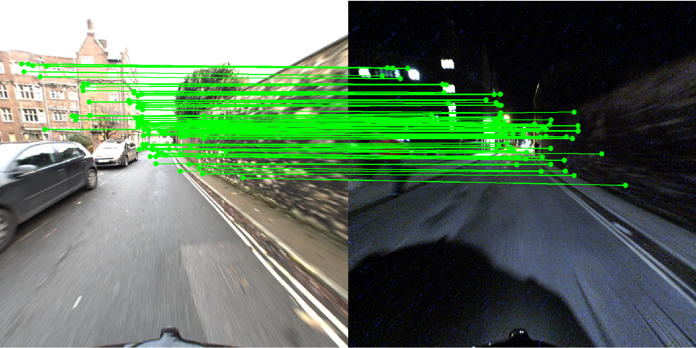
Number of matches
Standard sparse-to-sparse pipeline
Our sparse-to-dense pipeline
> Sparse-to-Dense Hypercolumn Matching for Long-Term Visual Localization, H. Germain, G. Bourmaud, V. Lepetit, 3DV 2019

Slide 14
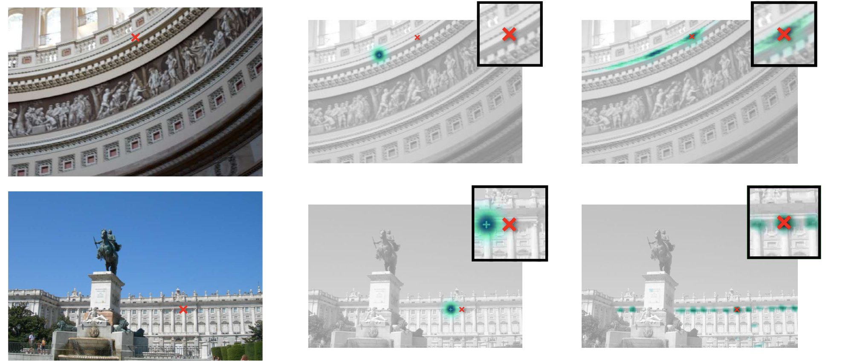
Next: Predicting a distribution on the location
RE
NRE
> Neural Reprojection Error: Merging Feature Learning and Camera Pose Estimation, H. Germain, V. Lepetit, G. Bourmaud, CVPR 2021

Slide 15
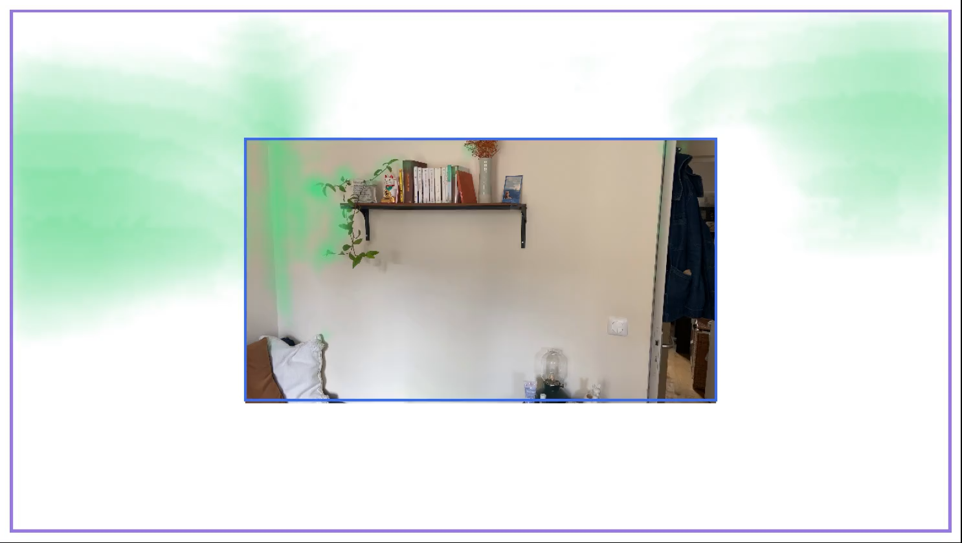
Going further: Dealing with non-covisibility
Source
Target Images
(processed independently)
> Visual Correspondence Hallucination, H. Germain, V. Lepetit, G. Bourmaud, ICLR 2022

Slide 16
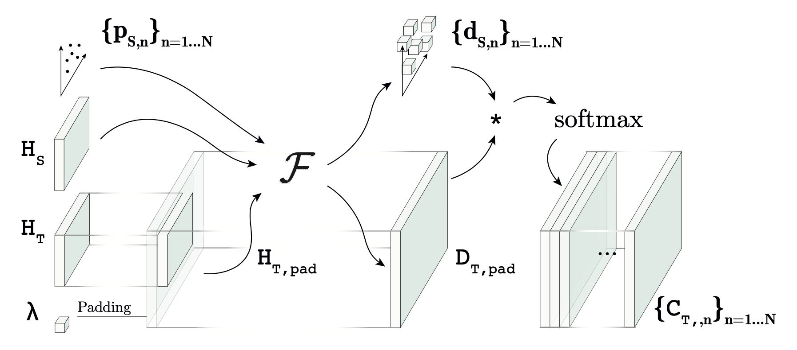
Visual Correspondence Hallucination
Learning matching probability distributions over non-covisible areas
Images are now processed jointly using attention mechanisms
Training is done on both covisible and non-covisible samples
> Visual Correspondence Hallucination, H. Germain, V. Lepetit, G. Bourmaud, ICLR 2022.

Slide 17
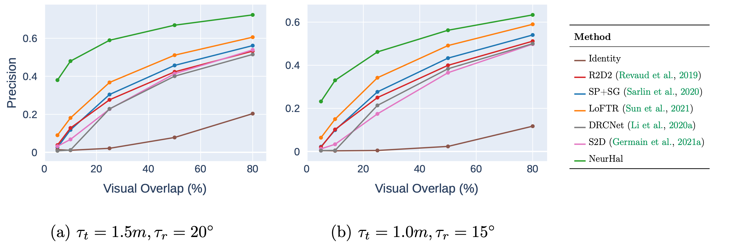
Application to camera pose estimation
Quantitative Results on ScanNet for low-overlap image pairs
> Visual Correspondence Hallucination, H. Germain, V. Lepetit, G. Bourmaud, ICLR 2022

Slide 18
Publications
Sparse-to-Dense Hypercolumn Matching for Long-Term Visual Localization, H. Germain, G. Bourmaud, V. Lepetit, 3DV 2019.
S2DNet: Learning Accurate Correspondences for Sparse-to-Dense Feature Matching, H. Germain, G. Bourmaud, V. Lepetit, ECCV 2020.
Neural Reprojection Error: Merging Feature Learning and Camera Pose Estimation, H. Germain, V. Lepetit, G. Bourmaud, CVPR 2021.
Visual Correspondence Hallucination, H. Germain, V. Lepetit, G. Bourmaud, ICLR 2022.

Slide 19
Thanks!

